Slide 1
Image Classification CNN for Car Make and Model
David Opie
Group 16

Slide 2
Introduction
Vehicle detection and identification is critical for enforcing traffic control, statistical analysis, and supporting law enforcement.
When identifying a vehicle, you need to know the make, model, and year of manufactory, e.g. 2012 Tesla Model S or 2012 BMW M3 coupe.
Stanford dataset: The Cars dataset contains 16,185 images of 196 classes of cars. The data is split into 8,144 training images and 8,041 testing images. (Not same size ☹)

Slide 3
Methodology
Create a basic CNN using Stanford dataset
Implement ResNet50, Fast-CNN, YOLO
Evaluate different CNN models against each other
Implement Live Vehicle Detection and Identification

Slide 4
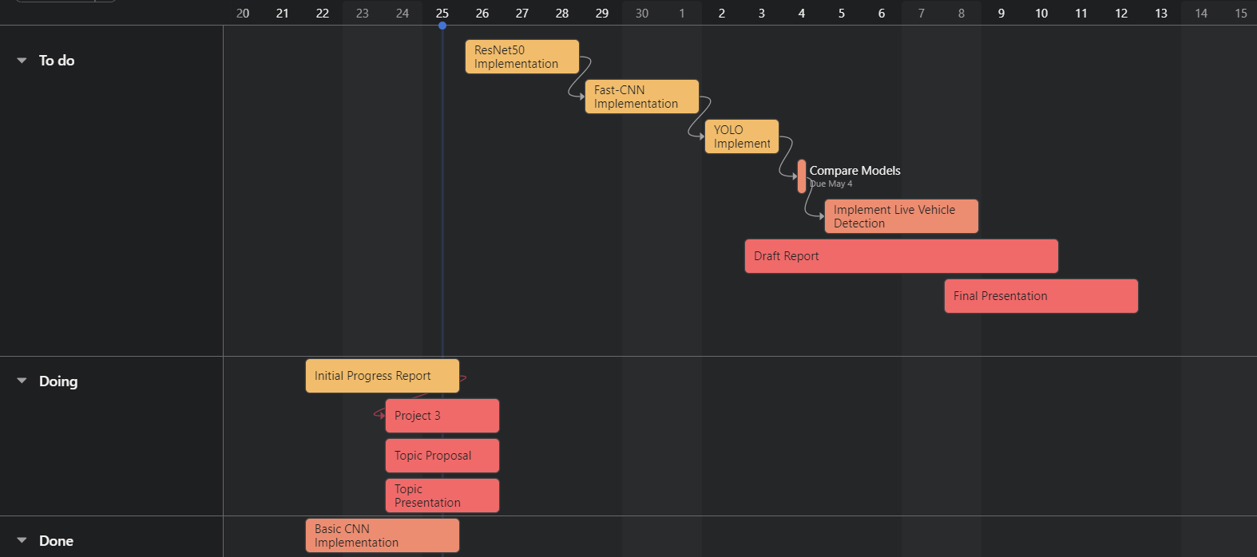
Objectives / Milestones
Implement Basic CNN
Implement ResNet-50
Implement Fast-CNN
Implement YOLO
Compare Models
Implement Live vehicle detection
Create Report
https://app.asana.com/

Slide 5
Plan for Evaluation and Demonstration
Evaluation: Accuracy & Loss metrics from training, validation, and testing.
Demonstration: Run an image of a car through the model and judge the label given to the image by the model.
Demonstration: Judge the live vehicle image identification algorithm if it outputs the correct label.

Slide 6
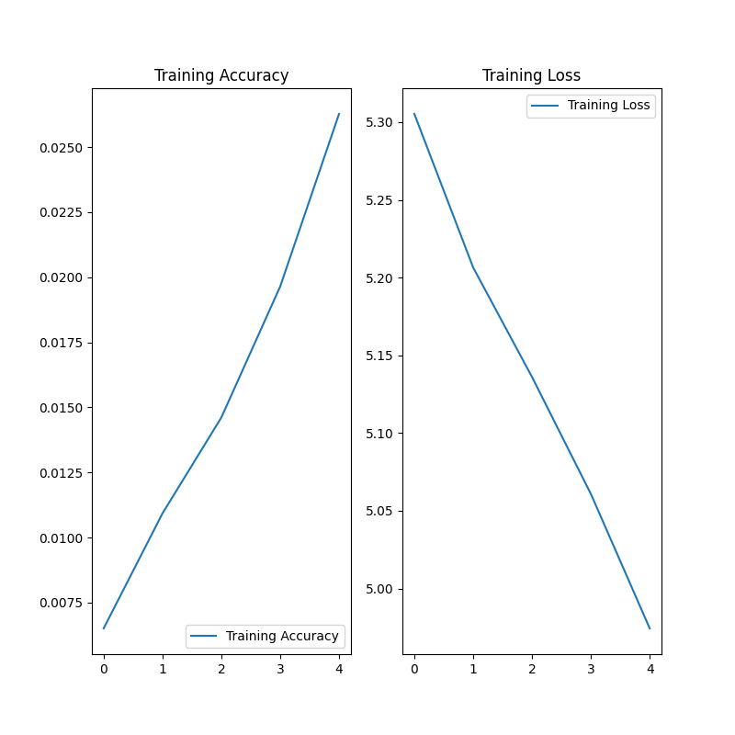
Initial Results
Our initial results show a very low training accuracy.
These results are to be expected as we are using a basic CNN model trained with only 5 epochs.

Slide 7
Basic CNN Model
_________________________________________________________________
Layer (type) Output Shape Param #
=================================================================
sequential (Sequential) (None, 200, 200, 3) 0
conv2d (Conv2D) (None, 200, 200, 17) 476
max_pooling2d (MaxPooling2D) (None, 100, 100, 17) 0
dropout (Dropout) (None, 100, 100, 17) 0
conv2d_1 (Conv2D) (None, 100, 100, 39) 6006
max_pooling2d_1 (MaxPooling2D) (None, 50, 50, 39) 0
conv2d_2 (Conv2D) (None, 50, 50, 87) 30624
max_pooling2d_2 (MaxPooling2D) (None, 25, 25, 87) 0
conv2d_3 (Conv2D) (None, 25, 25, 87) 68208
max_pooling2d_3 (MaxPooling2D) (None, 12, 12, 87) 0
conv2d_4 (Conv2D) (None, 12, 12, 87) 68208
max_pooling2d_4 (MaxPooling2D) (None, 6, 6, 87) 0
dropout_2 (Dropout) (None, 6, 6, 87) 0
flatten (Flatten) (None, 3132) 0
dense (Dense) (None, 500) 1566500
dense_1 (Dense) (None, 197) 98697
=================================================================
Total params: 1,838,719
Trainable params: 1,838,719
Non-trainable params: 0
_________________________________________________________________
The Stanford dataset does not have a standard size for each image.
The average dimension for the dataset is height=382 and weight=512.
CNNs require all input data to be the same shape, therefore we resize the dataset to be (200, 200).
If we could reshape the dataset around the cars our performance would increase.

Slide 8
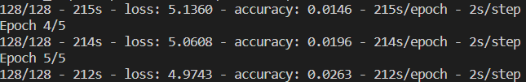
Need a stronger device
Over 20 minutes for only 5 epochs with my CPU-only laptop.
Google Colab can be used but I would need to create a new data pipeline with downloaded data as the Stanford Dataset has a url error in the tensorflow_dataset database.

Slide 9
Related Work
Krause, J., Stark, M., Deng, J., & Fei-Fei, L. (2013). 3D object representations for fine-grained categorization. 2013 IEEE International Conference on Computer Vision Workshops. https://doi.org/10.1109/iccvw.2013.77
Liu, D. & Wang, Y. (2015). Monza: Image Classification of Vehicle Make and Model Using Convolutional Neural Networks and Transfer Learning.
M. Maity, S. Banerjee and S. Sinha Chaudhuri, "Faster R-CNN and YOLO based Vehicle detection: A Survey," 2021 5th International Conference on Computing Methodologies and Communication (ICCMC), 2021, pp. 1442-1447, doi: 10.1109/ICCMC51019.2021.9418274.
C. M. Bautista, C. A. Dy, M. I. Mañalac, R. A. Orbe and M. Cordel, "Convolutional neural network for vehicle detection in low resolution traffic videos," 2016 IEEE Region 10 Symposium (TENSYMP), 2016, pp. 277-281, doi: 10.1109/TENCONSpring.2016.7519418.
Potdar, K., Pai, C. D., & Akolkar, S. (2018). A Convolutional Neural Network based Live Object Recognition System as Blind Aid. doi: https://doi.org/10.48550/arXiv.1811.10399
B. Benjdira, T. Khursheed, A. Koubaa, A. Ammar and K. Ouni. (2019). Car Detection using Unmanned Aerial Vehicles: Comparison between Faster R-CNN and YOLOv3. 1st International Conference on Unmanned Vehicle Systems-Oman (UVS), 2019, pp. 1-6, doi: 10.1109/UVS.2019.8658300.

